Slide 1

Recommender System to improve sales of ManyGiftsUK
Henrique Costa
Pedro Mendes
Rafael Soromenho
Rui Soromenho

Slide 2

Project Overview
Why?
Boost ManyGiftsUK sales
What?
Collaborative-Filtering
Cold-Start Problem
How?
Deployment Challenges
Notes:
The goal of this project is to develop a recommendation system that can help ManyGiftsUK in improving its sales.
Out The system should be able to identify which products are likely to be interesting for customers, enabling strategies to push such items resulting in more purchases.
It should consider two scenarios: to provide recommendations for customers with a significant transaction history and to generate recommendations for new customers – a challenge commonly referred to as ‘Cold Start’ problem.
While the results attained so far are suboptimal - as the collaborative-filtering strategy used is performing worse than a popular recommender - we still considered relevant to present the approach taken. In addition, we will also discuss the common challenges and limitations with recommender systems implementation.

Slide 3
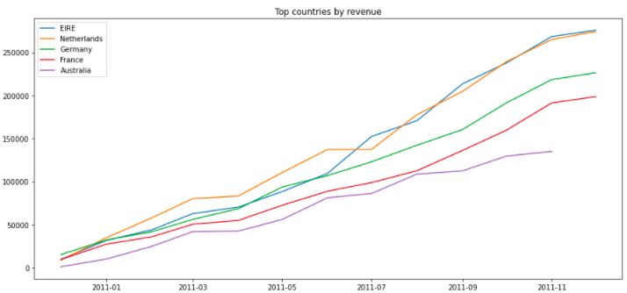
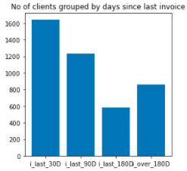
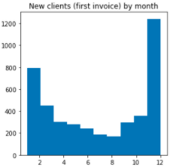
ManyGiftsUK
Overview
Dataset Attributes
25900 unique Transactions
38 unique Countries
4372 unique Customers
4070 unique Products
Notes:
Let's start with a brief overview of the dataset, it has around 26000 transactions, around 4000 products and customersID and 38 countries. However some of this records have issues, such as cancelled transactions, products without description or missing customerIDs that were dealt during data cleaning process.
Looking at the data it is possible to understand, not having UK into account has it represents the majority of market share, that the top 5 countries by revenue are Ireland, Netherlands, Germany, France and Australia. It’s also possible to see that the majority of clients made a purchase in the last 30 or 90 days.
Moreover there is evidence that new clients usually make their first purchase in December or January. Therefore, those are the months that ManyGifts want to capture new customers by offering them relevant item options.
Now my colleagues will explain to you the logic for the recommender system and some challenges that can arise with this implementation.

Slide 4
Collaborative Filtering
Clean Data
1
Create User-Item Matrix
2
Reduce Sparsity
3
Train-Test Split
4
Alternating Least Squares
5
Model Evaluation
6
Remove cancelations
Exclude irrelevant items (e.g. POST)
Preference
Confidence
Exclude less than 10 events
Ensure we recommend for future purchases
Optimize factors
Recommend
Recall of 0.07
Underperforms Popularity based
Notes:
Given the nature of information available, the project will focus on a collaborative filtering approach as it can make the best use of the implicit data that has been collected.
To produce the recommender model, transactions that corresponded to cancelations were excluded as well as irrelevant products (e.g. POST).
A user-item matrix was created representing preference and confidence for each pair. Having purchased the product in the past indicates preference while repeated purchases increases confidence in that preference.
To reduce sparsity items bought less than 10 times or customers that purchased less than 10 products were excluded.
Train and test were divided based on a timestamp to ensure all transactions in the train set were done previously to the ones in test.
An alternating least squares method was used to find the optimal user and item factors that were in turn used to make recommendations. Number of factors used was 200.
Model was evaluated based on recall at K with k equal to 10. This means that in 7% of the cases an item purchased by a user in the future would have been recommended by the system.
As previously mentioned the model needs to be further optimized as it is currently not performing better than a popular recommender.

Slide 5

Cold Start Problem
Recommendation system meets a user for the first time
There is no user history
Notes:
Regarding the cold start problem, as you know, the user cold start simply means that a recommendation system meets a visitor for the first time. Since there is no user history, the system doesn’t know the personal preferences of the user.
There are several ways to deal with this problem, we choose to deal with it using a popularity-based strategy, with a demographic filtering.

Slide 6


Solution: Popularity based strategy, with a demographic filtering
United Kingdom
Germany
1 | REGENCY CAKE STAND 3 TIER
2 | PARTY BUNTING
3 | WHITE HANGING HEART T-LIGHT HOLDER
4 | JUMBO BAG RED RETROSPOT
5 | PAPER CHAIN KIT 50'S CHRISTMAS
6 | CHILLI LIGHTS
7 | RABBIT NIGHT LIGHT
1 | REGENCY CAKE STAND 3 TIER
2 | ROUND SNACK BOXES SET OF 4 WOODLAND
3 | ROUND SNACK BOXES SET OF 4 FRUITS
4 | SPACEBOY LUNCH BOX
5 | PLASTERS IN TIN WOODLAND ANIMALS
6 | RED KITCHEN SCALES
7 | GUMBALL COAT RACK
Notes:
When a new user enters the system, we only have information about his location, with his IP. So we took advantage of that, building a recommending system based on the most popular products for each country.
For example, if I am a new ManyGift user and I access the website from The United Kingdom, the system will suggest me the most sold products in the United Kingdom, but if I access the website in Germany the recommendation system will suggest top sellers in Germany, that as you can see, out of the top 7 items only 1 is the same.

Slide 7
Deployment
Challenges & Recommendations
Notes:
Finally, we should focus on the deployment phase, where challenges in implementing the recommender system might happen with time.

Slide 8
What are the main challenges (and possible recommendations) in implementing a recommender system?
Deployment
Lack of data
Open-source data or partnerships
Changing data Social media feedback
Changing user preferences Focus on psychographics
Notes:
Let us focus our attention in 3 main challenges:
The first one, and probably the biggest, is lack of data: recommender systems need a lot of data to effectively make recommendations. It’s no coincidence that the companies most identified with having excellent recommendations are those with a lot of consumer user data like Google, Amazon, Netflix. The more item and user data a recommender system has to work with, the stronger the chances of getting good recommendations are and so, if needed, ManyGifts can retrieve more data from open-source datasets or establish partnerships with similar enterprises and share their database.
Regarding the second point, past behavior of users might not be a good tool because trends are always changing. For that reason it would be important to keep a close eye on social media in order to predict what the consumers are interested in an ever changing world.
Let me give you an example regarding the third topic: one day I will be browsing ManyGifts for new books for myself, but the next day I’ll be on your website searching for a birthday present for my sister. The point here is that one's preferences and needs will be changing constantly and so it is also important to try and understand their psychographics — how customers think, feel, and react as well as their values, attitudes, and biases.

Slide 9

Happy to take your questions
Notes:
As previously mentioned this is still an ongoing project. We do believe however that this approach has the potential to boost ManyGiftsUK sales.
For that reason we look forward to continue working to overcome our challenges and achieve more satisfying results!

